Slide 1

Introduction to
Features:
Computer Vision Fundamentals
Computer Vision Team

Slide 2

What Are Features?
• Features are distinctive elements or structures in
images.
• Used for matching, recognition, and reconstruction.
Common Types:
Edges
Corners
Blobs
Ridges

Slide 3

Why Are Features Important?
Enable Core Tasks Provide
Robustness
Object recognition
Scale variations
Rotation changes
Illumination shifts
Object tracking
Panorama stitching

Slide 4

Types of Features
Edge Features
Corner Features
Detected by gradients, Harris, Shi-Tomasi, FAST
e.g., Canny
Blob Features
Descriptors
Diﬀerence of Gaussians, SIFT, ORB, BRIEF
SIFT, SURF

Slide 5
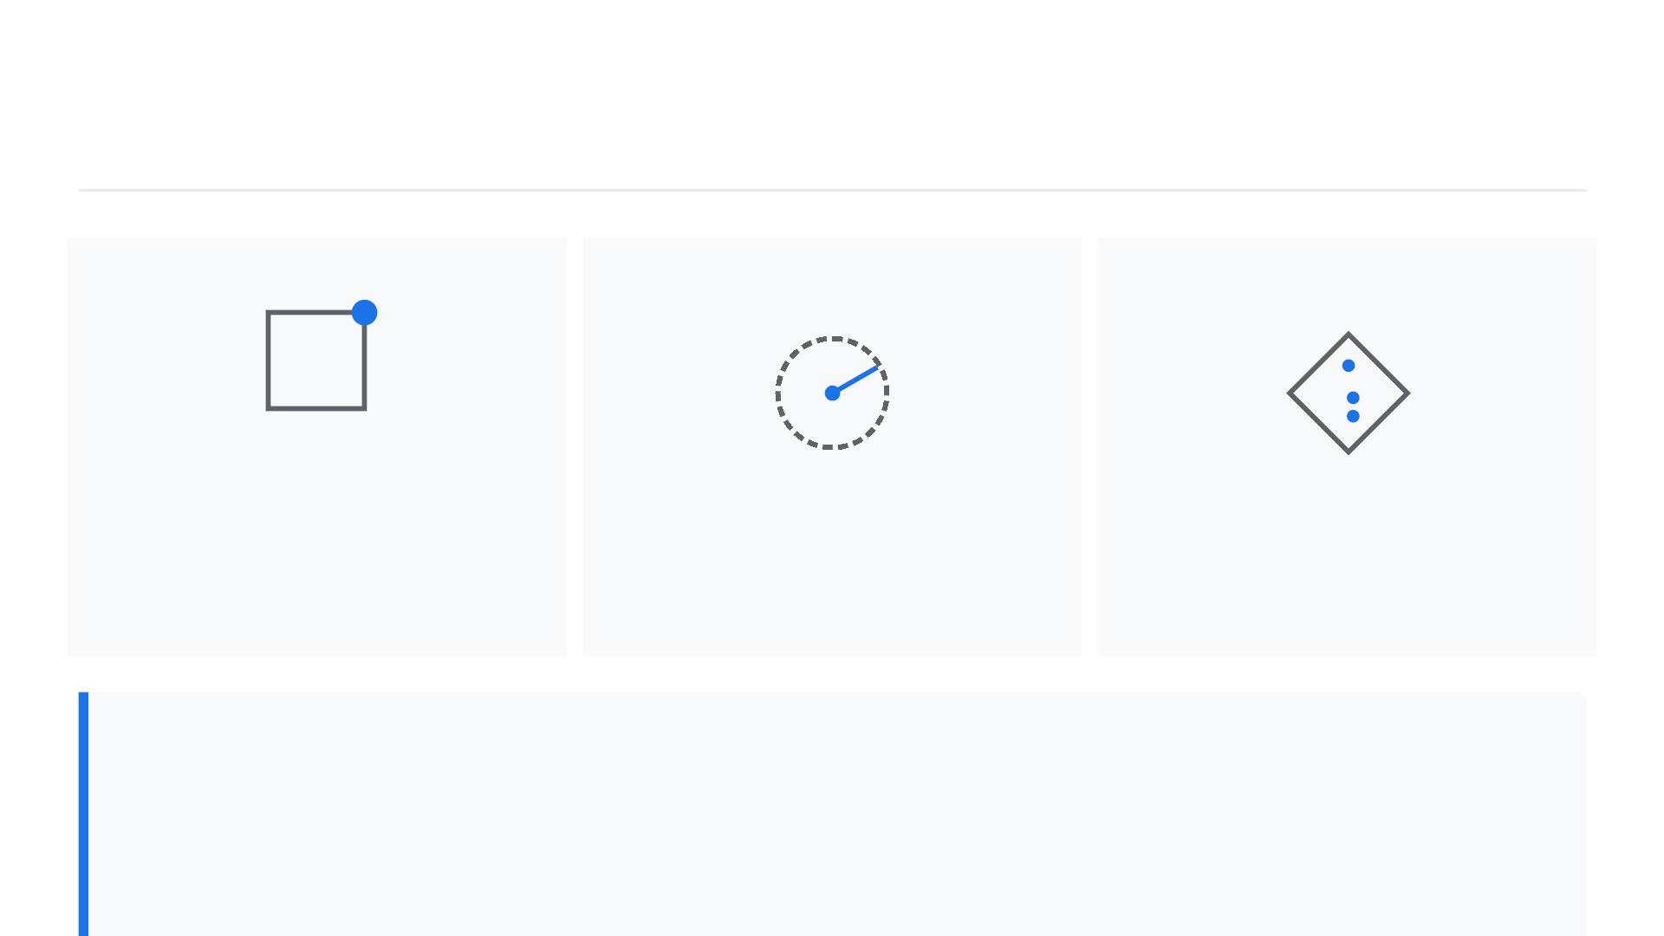
Visualizing Features (Examples)
Harris
Corners
SIFT
ORB
Variability: How diﬀerent are the features from each
other?
Repeatability: Can the same features be found in

Slide 6

Features in Panorama Images
• The Goal: Align overlapping
images to create a seamless
panorama.
• The Challenge: Finding
common features between
the overlapping regions.
Matched
Features
Feature Detection: Identify
distinct points (e.g., corners,
edges) in each image.
Image
Image B

Slide 7

How Panoramas Are Made
_{[01]}Detect features
_{[02]}Match features
_{[03]}Estimate transformation (homography)
[04]Blend

Slide 8
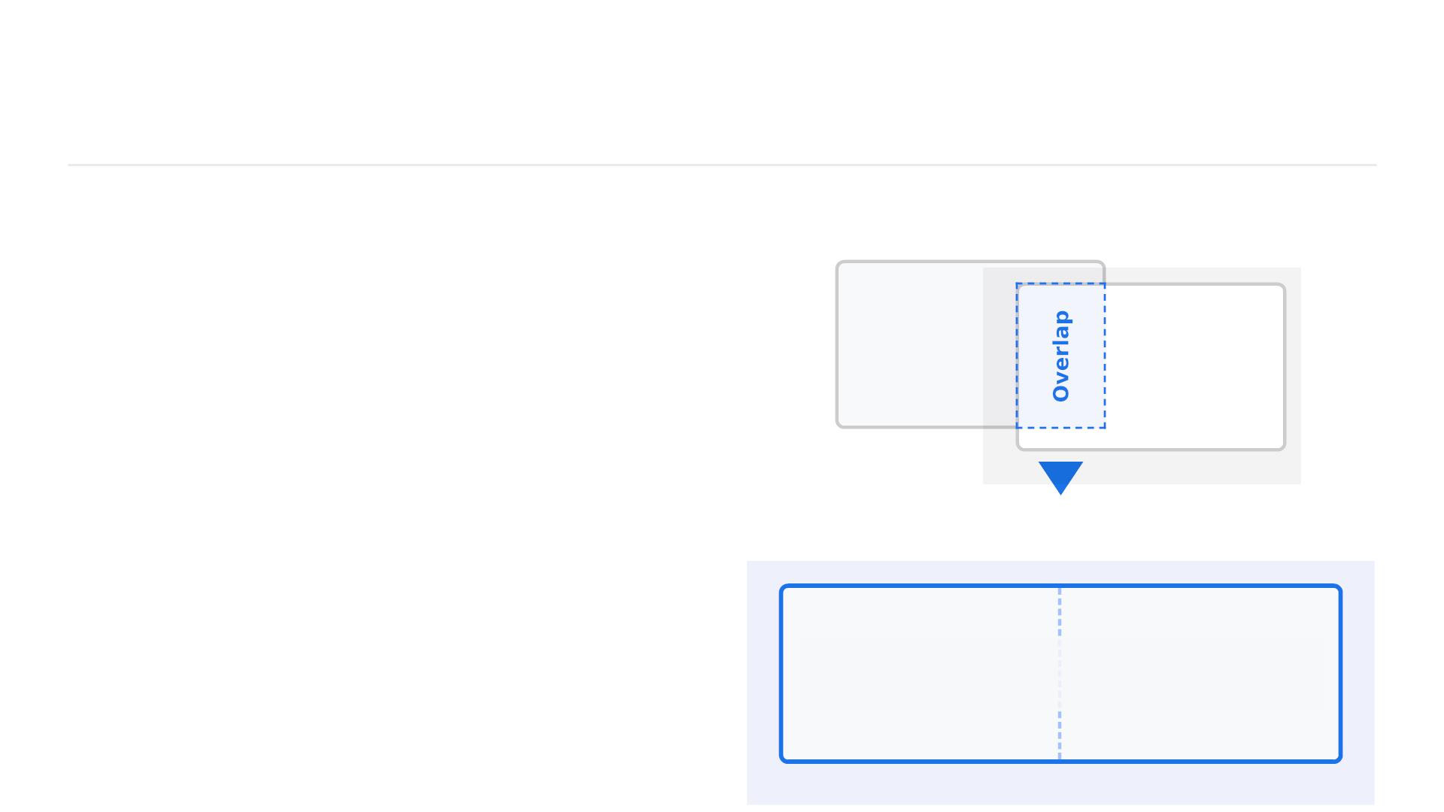
Panorama Example Image
•
Before State: Capturing a
scene requires taking
Before: Overlapping Photos
sequential photos with a
20-30% overlap to ensure
common features exist.
Imag
mage 2
•
After State: Computer
vision algorithms detect
features, align the images,
and blend them into a ﬁnal
stitched panorama.
After: Stitched Panorama
Seamless Panorama

Slide 9

Feature Detection Demo (Python /
OpenCV)
Python implementation of SIFT feature detection:
import cv2 as cv
import numpy as np
# Load the image in grayscale
img = cv.imread('target_image.jpg', cv.IMREAD_GRAYSCALE)
# Initialize the SIFT detector
sift = cv.SIFT_create()

Slide 10

Feature Detection Demo (Python /
OpenCV)
# Detect keypoints and compute descriptors
keypoints, descriptors = sift.detectAndCompute(img, None)
# Draw keypoints on the original image
img_with_keypoints = cv.drawKeypoints(
img,
keypoints,
None,
flags=cv.DRAW_MATCHES_FLAGS_DRAW_RICH_KEYPOINTS)

Slide 11

Feature Detection Demo (Python /
OpenCV)
Python implementation of SIFT feature detection:
# Display the result
cv.imshow('SIFT Features', img_with_keypoints)
cv.waitKey(0)
cv.destroyAllWindows()

Slide 12

Feature Matching Example
Implementing Brute-Force Matching with Lowe's Ratio Test
# Match descriptors.
matches = bf.knnMatch(des1, des2, k=2)
# Apply ratio test
good = []
for m, n in matches:
if m.distance < 0.75 * n.distance:
good.append([m])

Slide 13

Feature Matching Example
# create BFMatcher object
bf = cv2.BFMatcher()
# cv2.drawMatchesKnn expects list of lists as matches.
img3 = cv2.drawMatchesKnn(img1, kp1, img2, kp2, good, None, fla

Slide 14

Homography Estimation using
OpenCV
Calculate the perspective transformation matrix between
corresponding point sets:
import cv2
# Estimate the homography matrix between two sets of points
H, mask = cv2.findHomography(
srcPoints=src_pts,
dstPoints=dst_pts,
method=cv2.RANSAC,

Slide 15

Panorama Stitching - Blending
Example
• Applying the homography matrix to warp and blend
images:
import cv2
import numpy as np
# Assuming img1, img2 are loaded and H is the homography matrix
# Get dimensions of the destination image
height, width = img1.shape[:2]
# Warp img2 to img1's perspective using cv2.warpPerspective
warped_img = cv2.warpPerspective(img2, H, (width + img2.shape[1], height))
# Blend the images (simple overlay for demonstration)
warped_img[0:height, 0:width] = img1

Slide 16

Common Feature Detectors in
OpenCV
SIFT
ORB
AKAZE
Scale-Invariant Feature
Transform
Oriented FAST and
Rotated BRIEF
Accelerated-KAZE
■
High
■
Moderate
■
Good
Accuracy:
Excellent for
complex
Accuracy:
Good for
general use
cases.
Accuracy:
Better than
ORB, slightly
below SIFT.
matching tasks.

Slide 17

Summary: Computer Vision
Features
Importance of Features
Enable robust object recognition, tracking, and panorama
stitching across varying scales and illumination.
Types of Features
Categorized primarily into Edges (gradients), Corners
(Harris, FAST), and Blobs (SIFT, SURF).
OpenCV Tools for Detection & Stitching

Slide 18

Questions & Answers
Thank you for your attention.

